Slide 1
Intro devops
By lohith

Slide 2
Req of Devops
Requirement & Gathering analysis
Production feature users and market standard
Planning & design how to do ?
Developers phase
s/w tester or bugs
s/w running or not ?

Slide 3
Models
Waterfall
Agile
Spiral
Big bang
ETC
Note:
We follow only waterfall method
New ideas always add to the same project but we need uptime the system
Problems are :codes changes
Depoly code again
failures of testing/QA

Slide 4
How to work Devops
communication
integration
collaboration

Slide 5
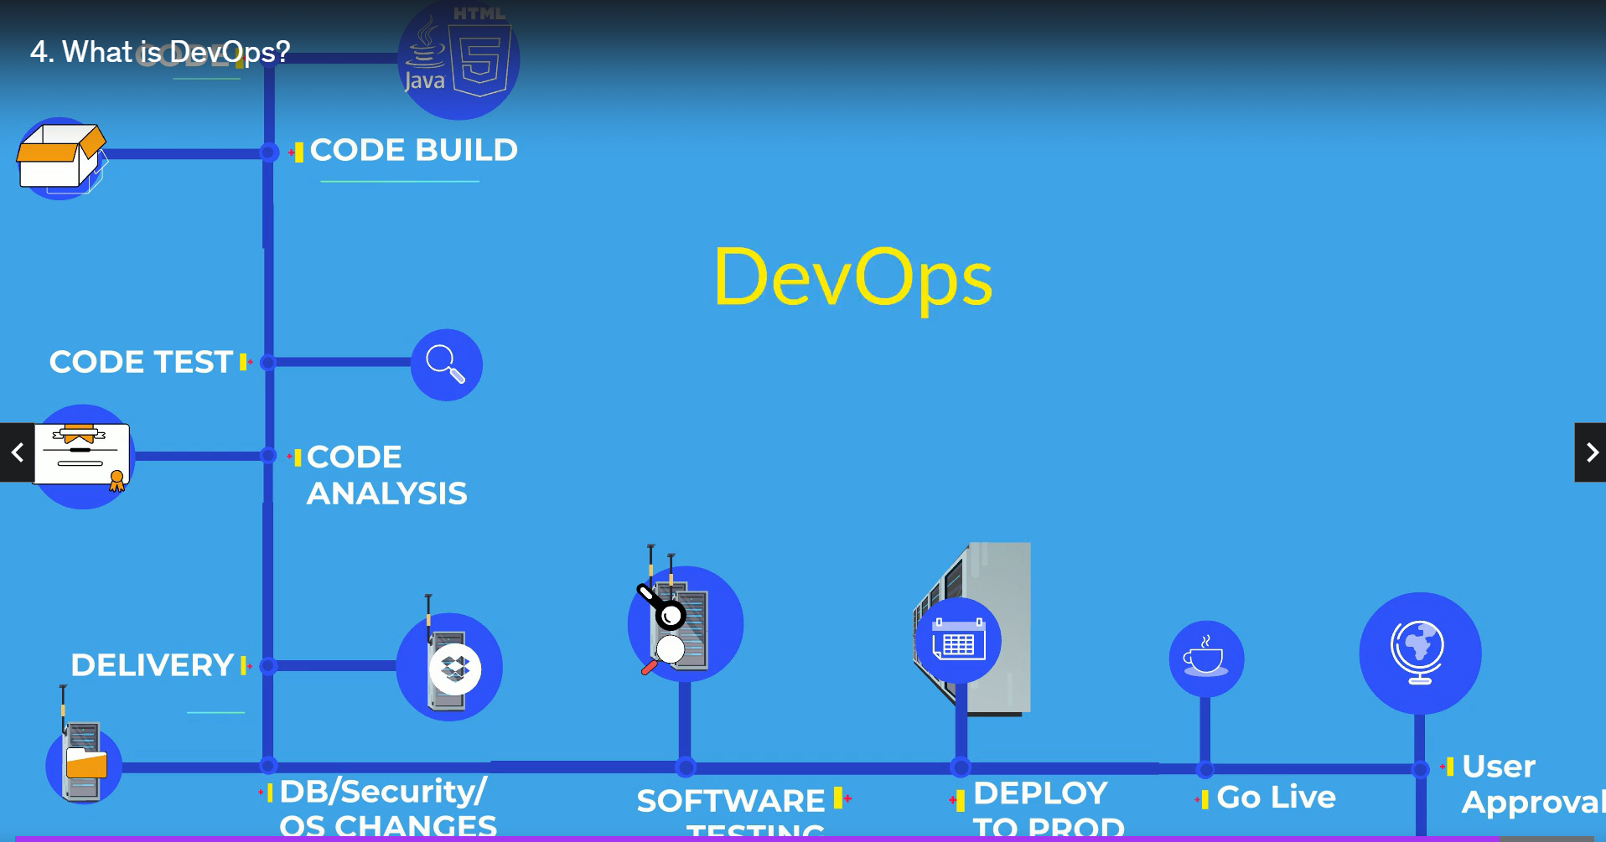
DevOps cycle

Slide 6
Linux Introduction
Basic Commands
➔ Open Terminal ➔ Know where you are? Present Working Directory
Create a directory/folder in your home directory
➔ Change your current working directory to linux-practices(Go to linux-practices folder).
Create some empty files with “touch” command and list them.
➔ Reconfirm your location in your system.

Slide 7
Absolute path and Relative path
What is an absolute path?
An absolute path is defined as the specifying the location of a file or directory from the root directory(/). In other words we can say absolute path is a complete path from start of actual filesystem from / directory.

Slide 8
Relative path
Relative path is defined as path related to the present working directory(pwd). Suppose I am located in /home/imran and I want to change directory to /home/imran/linux-practices. I can use relative path concept to change directory to linux-practices and also devopsdir directory.
Some examples of absolute path:
/home/lohith/linux-practices/
/var/ftp/pub
/etc/samba.smb.conf
/boot/grub/grub.conf
Note: If you see all these paths started from / directory which is a root directory for every Linux/Unix machine

Slide 9
Thank you

